Slide 1
Transmission Media

Slide 2
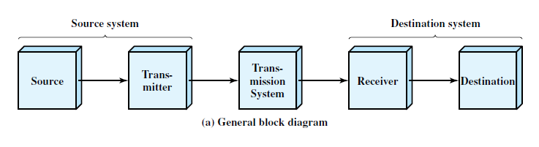
.

Slide 3
Communication media : Physical path between transmitter and receiver in a data communication system.
Important to study the characteristics of the popular transmission media.
ie data rate depends on bandwidth, signal to noise ratio
.

Slide 4
Classification:
Guided Media:
Waves are guided along the solid medium
Example : twisted pair, coaxial cable, optical fiber.
Unguided Media :
Provides a means for transmitting electromagnetic signals through but do not guide them.
Also called wireless transmission.
.

Slide 5
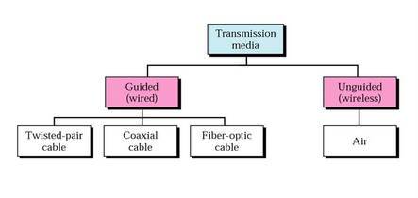
Classification diagram
.

Slide 6
Quality of transmission
Characteristics and quality of data transmission are determined by media and signal characteristics.
For Guided media, the medium is more important in determining the limitations of the transmission.
ie bandwidth, signal to noise ratio, attenuation.
For unguided media, the bandwidth of the signal produced by the transmission antenna is more important than the medium.
ie antenna will play a key role.
.

Slide 7
Design factors
Bandwidth
Transmission impairments
Interference
  is of particular concern for unguided media, but is also a problem with guided media.
  For guided media, interference can be caused by emanations from nearby cables.
Number of receivers
  A guided medium can be used to construct a point to-point link or a shared link with multiple attachments.
  In the latter case, each attachment introduces some attenuation and distortion on the line, limiting distance and/or data rate.
.

Slide 8

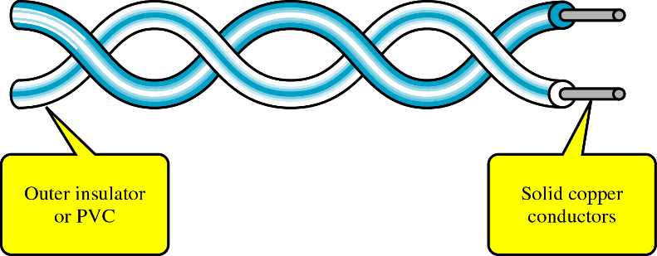
Twisted pair
Twisted pair consists of two insulated copper wires arranged in a regular spiral pattern.
.

Slide 9
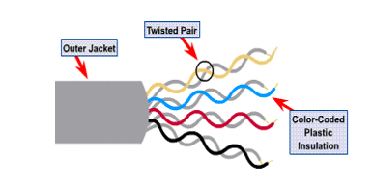
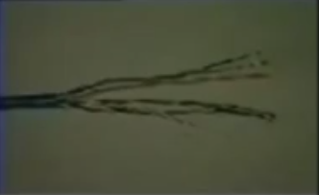
Twisted pair
Typically, a number of pairs are bundled together into a cable by wrapping them in a tough protective sheath.
.

Slide 10
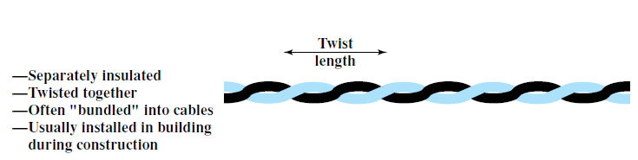
Why twisting
Signal passing in one pair of wire may induce signal on another pair of wire.
Twisting decreases the cross talk interference between adjacent pairs in a cable.
Tighter twisting produce much better performance, but also increases the cost.
.

Slide 11
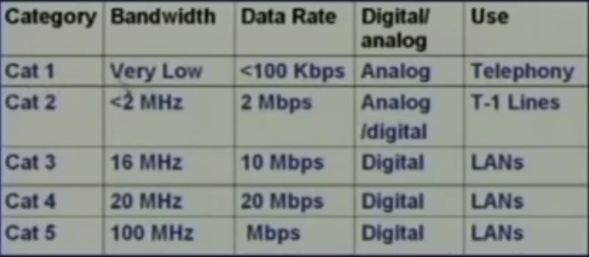
Twisted Pair Categories
.

Slide 12
Twisted Pair Categories
Two commonly used categories:
Category 3 : 10 mbps
Category 5: 100 mbps
.

Slide 13
Twisted Pair Categories
The key difference is the number of twists in the cable per unit distance.
Category 3 : 3-4 twists per feet
Category 5 : 3-4 twists per inch
.

Slide 14
Twisted Pair common types
Unshielded twisted pair(UTP)
Shielded twisted pair(STP)
.

Slide 15
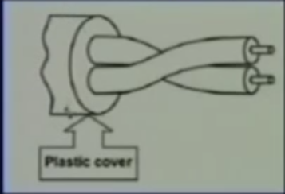
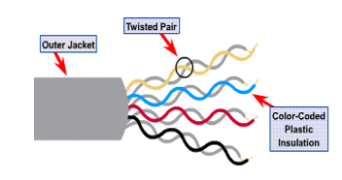
Unshielded Twisted Pair (UTP)
Ordinary telephone lines
Subject to electromagnetic interfernce. (spark, lightening)
.

Slide 16
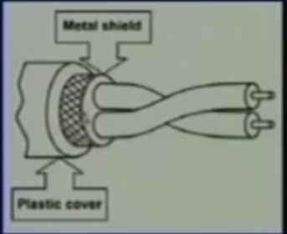
Shielded Twisted Pair (STP)
Has a metal foil or braided mesh covering that encases each pair of insulated conductor.
Expensive compare to UTP
Not popular in our day to day applications like telephone, LAN etc
.

Slide 17
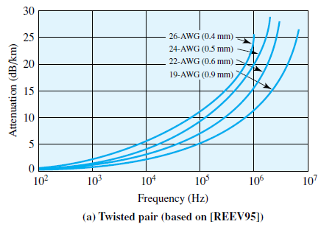
Attenuation characteristics of UTP
America Wire Guage (AWG)
.

Slide 18
Attenuation characteristics of UTP
Observation
As diameter of the conductor increases the atteαnuation decreases.
Higher the frequency, attenuation also increases.
As length increases attenuation is also increases.
Note : diameter α cost.
Attenuation α (distance) ²
.

Slide 19
Common Applications
Simplest and cheapest guided media used in many application.
Local loop in telephone lines.
Digital subscriber line (DSL)
Local area network
Connector used – RJ45
.

Slide 20
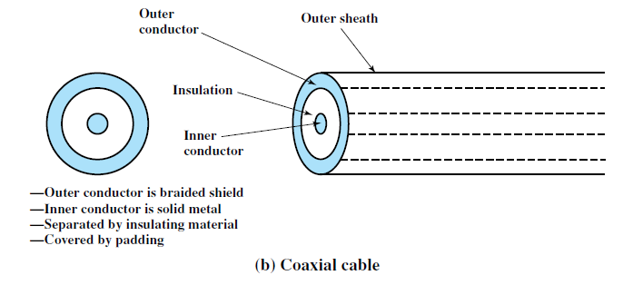
Coaxial cable
Consists of outer cylindrical conductor that surrounds a single inner wire conductor
The inner conductor is held in place by either regularly spaced insulating rings or a solid dielectric materials.
The outer conductor is covered with a jacket.
.

Slide 21

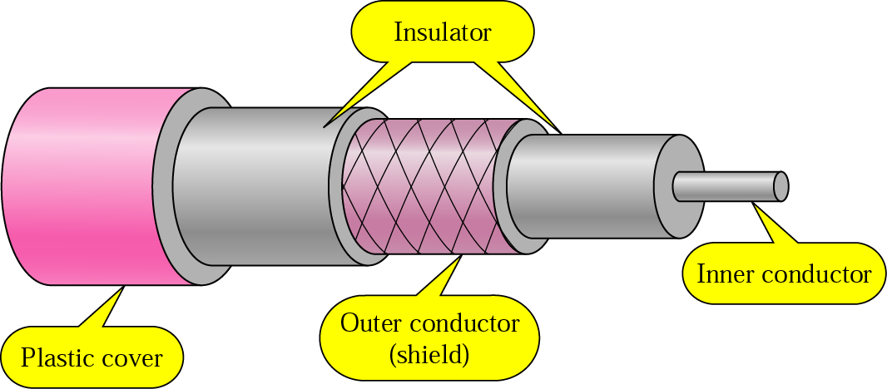
Coaxial cable
Due to its shielding, coaxial cables are much less susceptible to interference or crosstalk than twisted pair.
Category Use
RG-59 cable TV
RG-58 Thin Ethernet
RG-11 Thick ethernet
Radio Guage (RG)
.

Slide 22
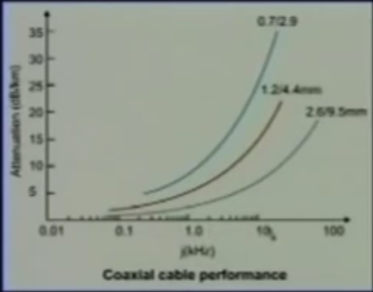
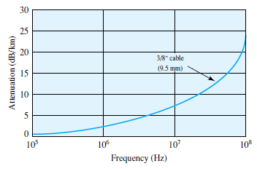
Performance
.

Slide 23
Common application
Television distribution
Long distance telephone transmission.
Local area network
.

Slide 24
Optical fiber
A fiber-optic cable is made of glass or plastic and transmits signals in the form of light.
.

Slide 25
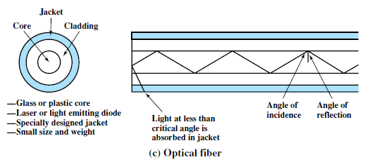
Optical Fiber
Physical Description
An optical fiber cable has a cylindrical shape and consists of three concentric sections: the core, the cladding, and the jacket .
.

Slide 26
Optical Fiber
Physical Description
core consists of one or more very thin strands, or fibers, made of glass or plastic;
Each fiber is surrounded by its own cladding, a glass or plastic coating that has optical properties different from those of the core.
.

Slide 27
Optical Fiber
Physical Description
The outermost layer, surrounding one or a bundle of cladded fibers, is the jacket.
The jacket is composed of plastic and other material layered to protect against moisture and other environmental dangers.
.

Slide 28
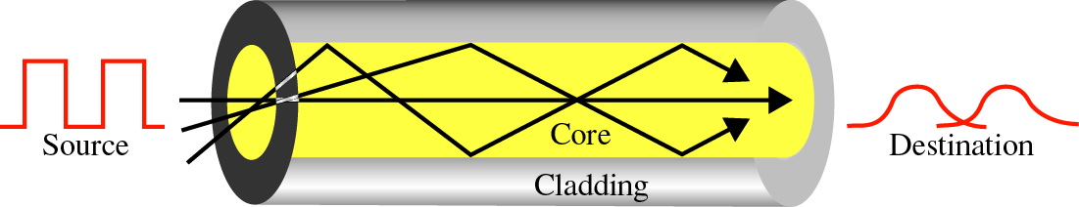
Optical Fiber
Core
Cladding
An optical fiber is made of three sections:
The core carries the light signals
The cladding keeps the light in the core
The coating protects the glass
Coating
.

Slide 29
Characteristics of Optical Fiber
Greater capacity:
  Data rate is high compared to twisted pair and coaxial cable.
  Data rates of hundreds of Gbps over tens of kilometers.
Smaller size and lighter weight:
  Thinner than coaxial cable or bundled twisted-pair cable
Lower attenuation:
  Attenuation is lower for optical fiber than for coaxial cable or twisted pair.
.

Slide 30
Optical Fiber
Electromagnetic isolation:
  Optical fiber systems are not affected by external electromagnetic fields.
  Thus the system is not vulnerable to interference, impulse noise, or crosstalk.
  Fibers do not radiate energy, so there is little interference with other equipment and there is a high degree of security from eavesdropping.
.

Slide 31
Optical Fiber
Greater repeater spacing:
  Fewer repeaters mean lower cost and fewer sources of error.
  Repeater spacing in the tens of kilometers for optical fiber is common.
  Coaxial and twisted-pair systems generally have repeaters every few kilometers.
.

Slide 32
Optical Fiber
Five basic categories of application have become important for optical fiber:
Long-haul trunks
  undersea optical fiber cable
Metropolitan trunks
  Underground conduits
Rural exchange trunks
Subscriber loops
  central exchange to a subscriber.
Local area networks.
.

Slide 33

Optical Fiber
Transmission Characteristics
Optical fiber transmits a signal-encoded beam of light by means of total internal reflection
cladding
core
.

Slide 34

Optical Fiber
Transmission Characteristics
Supports two modes (multimode and single mode) for propagating light along optical channels, each requiring fiber with different physical characteristics.
.

Slide 35
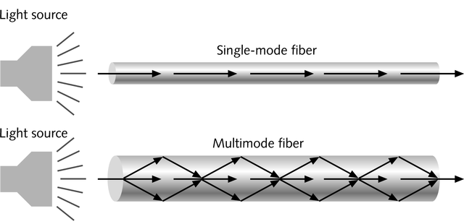
Optical Fiber
Transmission Characteristics
.

Slide 36
Optical Fiber
Transmission Characteristics
Single-mode fiber :
Carries light pulses by laser along single path.
When the fiber core radius is reduced, fewer angles will reflect.
Provides superior performance because there is a single transmission path with single-mode transmission.
Used for long distance applications, including telephone and cable television.
.

Slide 37
Optical Fiber
Transmission Characteristics
Multimode fiber :
Many pulses of light generated by LED travel at different angles.
With multimode transmission, multiple propagation paths exist.
limits the rate at which data can be accurately received.
Best suited for transmission over very short distances.
.

Slide 38

Optical Fiber
Transmission Characteristics
Figure 4.4 Optical Fiber Transmission Modes
.

Slide 39
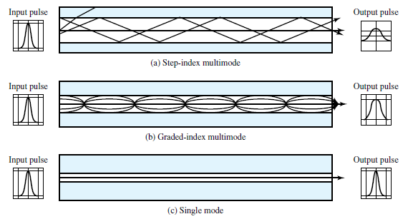
Optical Fiber
Transmission Characteristics
.

Slide 40
Optical Fiber
Transmission Characteristics
step-index
In multimode step-index fiber, the density of the core remains constant from the center to the edges.
At the interface, there is an abrupt change due to a lower density; this alters the angle of the beam's motion.
suddenness of this change, which contributes to the distortion of the signal.
.

Slide 41
Optical Fiber
Transmission Characteristics
graded-index multimode.
A graded-index fiber, is one with varying densities.
Density is highest at the center of the core and decreases gradually to its lowest at the edge.
Decreases this distortion of the signal through the cable.
used in local area networks.
.

Slide 42
Optical Fiber
Transmission Characteristics
Two different types of light source are used:
  light emitting diode (LED) and
  injection laser diode (ILD).
Both emit a beam of light when a voltage is applied.
The LED is less costly, operates over a greater temperature range, and has a longer operational life.
The ILD, which operates on the laser principle, is more efficient and can sustain greater data rates.
.

Slide 43
Optical Fiber
Transmission Characteristics
LED
  cheaper
  operates over a greater temperature range
  longer operational life.
  shorter distance
ILD
  costlier
  greater data rate
  Longer distance
.

Slide 44



